Slide 1
Informatica PowerCenter
Lesson 7- Additional Transformations

Slide 2
Lesson Objectives
In this lesson you will learn about:
  Router Transformation
  Sorter Transformation
  Stored Procedure Transformation
  Sequence Generator Transformation
  Union Transformation
  Reusable Transformations
  Shared Folder

Slide 3
7.1. Router Transformation Description
A Router Transformation is used to test input data for multiple conditions
It is an Active Transformation
A Router Transformation:
  Tests data for one or more conditions
  Gives the option to route rows of data that do not meet any of the conditions to a default output group
A Router Transformation is more efficient
Notes:
A Router Transformation is similar to a Filter Transformation because both transformations allow to use a condition to test data. A Filter Transformation tests data for one condition and drops the rows of data that do not meet the condition. However, a Router Transformation tests data for one or more conditions and gives the option to route rows of data that do not meet any of the conditions to a default output group.
The Router Transformation is more efficient. For example, to test data based on three conditions, only one Router Transformation needs to be configured instead of three Filter Transformations to perform this Task. Likewise, when a Router Transformation is used in a mapping, the Integration service processes the incoming data only once. When multiple Filter Transformations are used in a mapping, the Integration service processes the incoming data for each transformation.

Slide 4
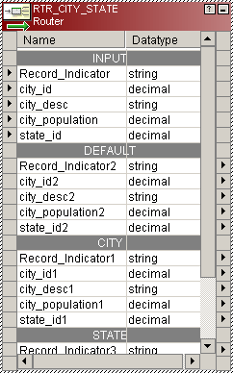
Router Transformation Components
Input Ports
Input Group
Deafult
Output Group
Output Ports
User Defined
Output Groups
Figure 7.1
Notes:
Router Transformation tests data for one or more conditions and gives the option to route rows of data that do not meet any of the conditions to a default output group.
A Router Transformation has the following types of groups:
Input Group
The Designer copies property information from the input ports of the input group to create a set of output ports for each output group.
Output Groups
There are two types of output groups:
User-defined groups – as per the user requirements, like in the above diagram CITY and STATE are two user-defined groups
Default group - Rows of data that do not meet any of the user defined conditions are routed to a default output group

Slide 5
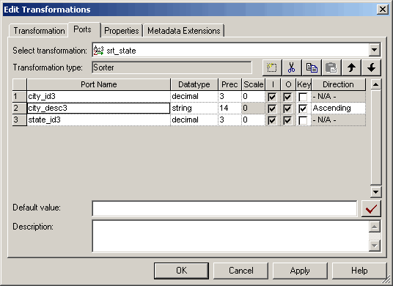
7.2. Sorter Transformation Description
The Sorter Transformation allows to sort data in ascending or descending order
It is an Active Transformation
Sorting can be case-sensitive
Distinct output rows can be specified
Figure 7.2
Notes:
The Sorter Transformation can sort data from relational tables or flat files. Sort takes place on the Integration service machine. Multiple sort keys are supported. The Sorter Transformation is often more efficient than a sort performed on a database with an ORDER BY clause.
The Sorter Transformation can also be used to sort data passing through an Aggregator Transformation configured to use sorted input.
When a Sorter Transformation is created in a mapping, one or more ports can be specified as a sort key and configure each sort key port to sort in ascending or descending order.

Slide 6
Demo
Configure a Router and Sorter Transformation
Notes:
Steps to create a Router Transformation:
In the Mapping Designer, open a mapping.
Choose Transformation | Create menu option. Select Router Transformation, and enter the name of the new transformation. The naming convention for the Router Transformation is RTR_TransformationName. Click Create, and then click Done.
Select and drag all the desired ports from a transformation to add them to the Router Transformation, or manually create input ports on the Ports tab.
Double-click the title bar of the Router Transformation to edit transformation properties.
Click the Transformation tab and configure transformation properties as desired.
Click the Groups tab, and then click the Add button to create a user-defined group. The Designer creates the default group when the first user-defined group is created.
Click the Group Filter Condition field to open the Expression Editor.
Enter a group filter condition.
Click Validate to check the syntax of the conditions entered.
Click OK.
Connect group output ports to transformations or targets.
Choose Repository | Save menu option.

Slide 7
7.3. Stored Procedure Transformation
Description
A stored procedure is a precompiled collection of SQL statements and optional flow control statements, similar to an executable script stored and run within the database
A Stored Procedure Transformation is used to call a database store procedure to perform a query or calculation that would otherwise be configured in a mapping
It is a Passive Transformation
Notes:
Database developers and programmers use stored procedures for various Tasks within databases, since stored procedures allow greater flexibility than SQL statements. Stored procedures also provide error handling and logging necessary for critical Tasks. Developers create stored procedures in the database using the client tools provided with the database.
A Stored Procedure Transformation is used to call a store procedure created in the database to perform a query or calculation that would otherwise be configured in a mapping.
For example, if there is a well-tested stored procedure for calculating sales tax created in the database, a Stored Procedure Transformation calling the database stored procedure can be configured, instead of recreating the same calculation in an Expression Transformation.
The stored procedure must exist in the database before creating a Stored Procedure Transformation, and the stored procedure can exist in a source, target, or any database with a valid connection to the Integration service.

Slide 8
7.3. Stored Procedure Transformation
Connected/Unconnected
Connected | Unconnected
Part of the mapping data flow | Separate from the mapping data flow
The mapping data passes through this transformation | It either runs before or after the session, or is called by an expression in another transformation in the mapping.
Returns multiple values (by linking output ports to another transformation) | Returns one value. PROC_RESULT is used in the parameter list of the stored procedure call to designate the return value
Notes:
Connected Stored Procedure Transformation
The flow of data through a mapping in connected mode also passes through the Stored Procedure Transformation. All data entering the transformation through the input ports affects the stored procedure. A connected Stored Procedure Transformation should be used when needed data from an input port sent as an input parameter to the stored procedure, or the results of a stored procedure sent as an output parameter to another transformation.
Unconnected Stored Procedure Transformation
The Unconnected Stored Procedure Transformation is not connected directly to the flow of the mapping. It either runs before or after the session, or is called by an expression in another transformation in the mapping.

Slide 9
Demo
Creating a Stored Procedure Transformation
Notes:
Steps to create a Stored Procedure Transformation:
Create the stored procedure in the database and test it through the provided database client tools.
Import or create the Stored Procedure Transformation, by providing ports for any necessary input/output and return values.
Determine whether to use the transformation as connected or unconnected. Determine how the stored procedure relates to the mapping before configuring the transformation.
If connected, map the appropriate input and output ports. Click and drag the appropriate input flow ports to the transformation, and create mappings from output ports to other transformations.
If unconnected, configure it to run from an expression in another transformation. The expression can contain variables, and may or may not include a return value.
Configure the session. The session properties in the Workflow Manager includes options for error handling when running stored procedures and several SQL override options.

Slide 10
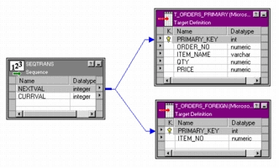
7.4. Sequence Generator Transformation
Description
The Sequence Generator Transformation is used to generate numeric values
It is a Passive Transformation
It has two predefined output ports
  CURRVAL
  NEXTVAL
The output ports cannot be changed
No ports can be added
Figure 7.3
Notes:
A Sequence Generator Transformation can be used to generate numeric values for the following:
Create keys
Replace missing values
Cycle through a sequential range of numbers
NEXTVAL
The NEXTVAL port is used to generate a sequence of numbers by connecting it to a transformation or target.
It is used to connect to a downstream transformation to generate the sequence based on the Current Value and Increment By properties. It can be connected to multiple transformations to generate unique values for each row in each transformation.
For example, NEXTVAL can be connected to two target tables in a mapping to generate unique primary key values. The Integration service creates a column of unique primary key values for each target table. The figure above illustrates connecting NEXTVAL to two target tables in a mapping.
Approximately two billion primary or foreign key values can be created with the Sequence Generator by connecting the NEXTVAL port to the desired transformation or target and using the widest range of values (1 to 2147483647) with the smallest interval (1).
CURRVAL
CURRVAL is the NEXTVAL value plus one or NEXTVAL plus the Increment By value. When a row enters the transformation connected to the CURRVAL port, the Integration service passes the last-created NEXTVAL value plus one.

Slide 11
Demo
Creating a Sequence Generator Transformation
Notes:
Steps to create a Sequence Generator Transformation:
In the Mapping Designer, select Transformation | Create. Select the Sequence Generator transformation. The naming convention for Sequence Generator Transformations is SEQ_TransformationName.
Enter a name for the Sequence Generator, and click Create. Click Done.
Double-click the title bar of the transformation to open the Edit Transformations dialog box.
Enter a description for the transformation. This description appears in the Repository Manager, making it easier to understand what the transformation does.
Select the Properties tab. Enter settings as necessary.
Note: Unlike other transformations, the Sequence Generator Transformation properties cannot be overridden at the session level. This protects the integrity of the sequence values generated.
Click OK.
To generate new sequences during a session, connect the NEXTVAL port to at least one transformation in the mapping. The NEXTVAL or CURRVAL ports can be used in an expression in other transformations.
Choose Repository | Save.

Slide 12
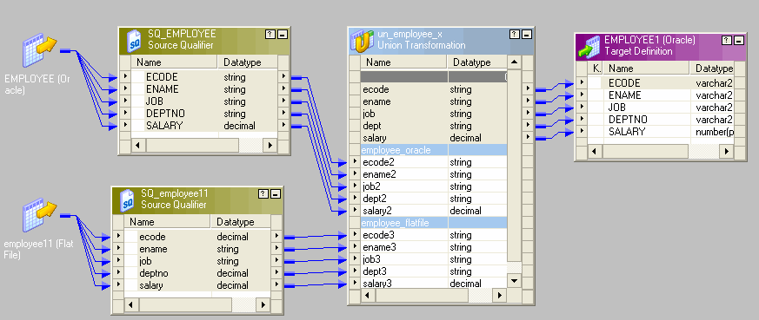
7.5. Union Transformation Description
Union transformation is used to merge data from multiple input sources into one output target.
The Union transformation is an active transformation
Reverse of a Router transformation
Figure 7.4
Notes:
The Union transformation is a multiple input group transformation that you can use to merge data from multiple pipelines or pipeline branches into one pipeline branch. Using the Union transformation to merge data from multiple sources is similar to using the UNION ALL SQL statement to combine the results from two or more SQL statements.
You can connect heterogeneous sources to a Union transformation. The Union transformation merges sources with matching ports and outputs the data from one output group with the same ports as the input groups.
Rules and Guidelines
Consider the following rules and guidelines when you work with a Union transformation:
You can create multiple input groups, but only one output group.
All input groups and the output group must have matching ports. The precision, datatype, and scale must be identical across all groups.
The Union transformation does not remove duplicate rows. To remove duplicate rows, you must add another transformation such as a Router or Filter transformation.
You cannot use a Sequence Generator or Update Strategy transformation upstream from a Union transformation.
The Union transformation does not generate transactions.

Slide 13
Demo
Creating a Union Transformation
Notes:
Steps to create a Union Transformation:
In the Mapping Designer, select Transformation | Create. Select the Union transformation. The naming convention for Union Transformations is UN_TransformationName.
Enter a name for the Union Transformations, and click Create. Click Done. The Designer creates the Union Transformation.
Double-click the title bar of the transformation to open the Edit Transformations dialog box.
Enter a description for the transformation. This description appears in the Repository Manager, making it easier to understand what the transformation does.
Click the Groups tab.
Add an input group for each pipeline or pipeline branch you want to merge. The Designer assigns a default name for each group. The groups can be renamed.
Click the Group Ports tab.
Add a new port for each row of data you want to merge. Enter port properties such as name and datatype.
Click the Properties tab to configure the tracing level.
Click OK.
Choose Repository | Save to save changes.

Slide 14
7.6. Reusable Transformations Description
Reusable Transformations are transformation objects which are defined once and used multiple times in any number of mappings
A reusable transformation is created in two ways:
  Using the Transformation Developer
  Promoting a standard Mapping transformation as reusable
All the transformation objects can be reusable except for:
  Source Qualifier Transformation
  ERP Source Qualifier Transformation
Notes:
Mappings contain two classes of transformations, standard and reusable. Transformations created in a mapping are standard, they cannot be used in any other mapping. If a transformation is common in multiple mappings then, it can be made reusable.
Reusable Transformations are transformation objects which are defined once and can be used multiple times in any number of mappings.
Reusable Transformations have an additional advantage in that every instance of the transformation that appears in the mapping inherits any changes made to the original transformation. The Designer stores each reusable transformation as metadata separate from any mappings that use the transformation.
Except for the Source Qualifier and the ERP Source Qualifier, all of the transformation objects can be reusable.
They can be created in two ways:
By promoting a standard transformation in the Mapping Designer
By creating the transformation in the Transformation Developer
Once a reusable transformation has been created, it can only be edited in the Transformation Developer.

Slide 15
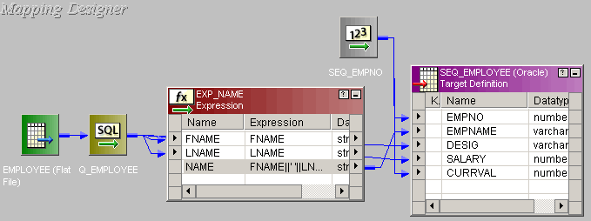
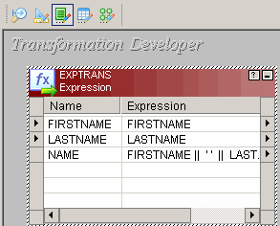
7.6. Reusable Transformations Instances
When a Reusable transformation is added to a mapping, an instance of the Reusable transformation gets added
If the Reusable transformation is changed, all instances of the Reusable transformation automatically inherit the changes
Instance of the Reusable Transformation in a mapping
Reusable Expression Transformation
Figure 7.6
Figure 7.5
Notes:
When a Reusable Transformation is added to a mapping, a copy (or instance) of the transformation gets added. The definition of the transformation still exists outside the mapping.
The instance of a Reusable Transformation is a pointer to that transformation. When the transformation in the Transformation Developer is changed, its instances automatically reflect the changes. This feature saves a great deal of work. Instead of updating the same transformation in every mapping, the Reusable transformation can be updated once. All instances of the transformation will automatically inherit the change.
Note: Instances do not inherit changes to property settings, only modifications to ports, expressions, and the name of the transformation.
As seen in the above example, we can configure an Expression Transformation to concatenate ‘First name’ and ‘Last name’. This expression can now be used in any mapping where the concatenation of names is required.

Slide 16
Demo
Creating a Reusable Transformation
Notes:
Steps to create a Reusable Transformation:
In the Designer, switch to the Transformation Developer.
Click the button on the Transformation toolbar corresponding to the type of transformation to be created.
Click and drag within the workbook to create the transformation.
Double-click the transformation title bar to open the dialog displaying its properties.
Click the Rename button and enter a descriptive name for the transformation, and click OK. The naming convention for Reusable Transformations is reuTransformation_Name.
Click the Ports tab, then add any input and output ports needed for this transformation.
Set the other properties of the transformation, and click OK. These properties vary according to the transformation created. For example, if an Expression Transformation is created, an expression for one or more of the transformation output ports is to be entered. If a Stored Procedure Transformation is created, identify the stored procedure to be called.
Choose Repository | Save.

Slide 17
Summary
After completing this lesson you now know:
  Router Transformation
  Sorter Transformation
  Stored Procedure Transformation
  Sequence Generator Transformation
  Union Transformation
  Reusable Transformations

Slide 18
Shared Folder
You can designate a folder to be shared.
In the Designer, shared folders allow users to create shortcuts to objects in the folder.
If you have an object that you want to use in several mappings or across multiple folders, you can place the object in a shared folder.
You can access the object from other folders by creating shortcuts to the object.
Shortcuts inherit changes to the original object.
When you create a shared folder, the folder icon in the Navigator displays an open hand icon.

Slide 19
Demo
Create and use a shared folder

Slide 20
XML Transformation
Different types of XML Transformation are
  XML Source Qualifier Transformation
  XML Parser Transformation
  XML Generator Transformation Overview
  XML Source Qualifier Transformation
  It’s an Active Transformation, as well as Connected.
  Just like the normal Source Qualifier Transformation we can use the XML Source Qualifier Transformation by dragging an XML source definition to the Mapping Designer workspace or by manually creating one.
  The source definition needs to be connected to the target via XML Source Qualifier Transformation. This Source qualifier defines the data elements that the Integration Service reads when it executes a session.
  XML Source Qualifier has one input or output port for every column in the source.
  If you remove an XML source definition from a mapping, the Designer also removes the corresponding XML Source Qualifier transformation. But we can link one XML source definition to one XML Source Qualifier transformation.
  Also we can link ports of XML Source Qualifier Transformation to ports of different transformations

Slide 21
XML Transformation
Continued ……..
XML Parser Transformation
  It’s an Active Transformation, as well as Connected.
  We use an XML Parser transformation to extract XML inside a pipeline and then pass this to the target.
  The XML is extracted from the source systems such as files or databases. The XML Parser transformation reads XML data from a single input port and writes data to one or more output ports.
XML Generator Transformation Overview
  It’s an Active Transformation, as well as Connected.
  We use XML Generator Transformation Overview to create XML inside a pipeline. It reads data from source such as files and databases and generates XML in the pipeline. The XML Generator transformation accepts data from multiple ports and writes XML through a single output port.

Slide 22
Demo
Creating a XML Transformation
Notes:
Steps to create a Reusable Transformation:
In the Designer, switch to the Transformation Developer.
Click the button on the Transformation toolbar corresponding to the type of transformation to be created.
Click and drag within the workbook to create the transformation.
Double-click the transformation title bar to open the dialog displaying its properties.
Click the Rename button and enter a descriptive name for the transformation, and click OK. The naming convention for Reusable Transformations is reuTransformation_Name.
Click the Ports tab, then add any input and output ports needed for this transformation.
Set the other properties of the transformation, and click OK. These properties vary according to the transformation created. For example, if an Expression Transformation is created, an expression for one or more of the transformation output ports is to be entered. If a Stored Procedure Transformation is created, identify the stored procedure to be called.
Choose Repository | Save.

Slide 23
Review Question
Question 1: The _______ transformation tests input data for multiple conditions
Question 2: The _______ port generates numeric values in a Sequence Generator Transformation
Question 3: A Stored Procedure Transformation is an Active transformation.
  True/False
Question 4: ________ is the reverse of a router transformation
Question 5: Reusable transformation can be configured in the Mapping Designer.
  True/False

